Slide 1
Open-compartment open model
Determination of pharmacokinetic parameters from urinary excretion data after IV bolus administration
Asisstant lecturer : Noor Yousif Fareed

Slide 2
IV bolus administration

Slide 3
Determination of pharmacokinetic parameters from urinary excretion data after IV bolus administration

Slide 4
Urine Sample
The concentration of drug in urine
Volume of the urine sample

Slide 5
Methods to estimate pharmacokinetic parameters from urinary excretion data.
Rate excretion method and
The ''amount remaining to be excreted'' (ARE) method, also known as the sigma-minus method.

Slide 6
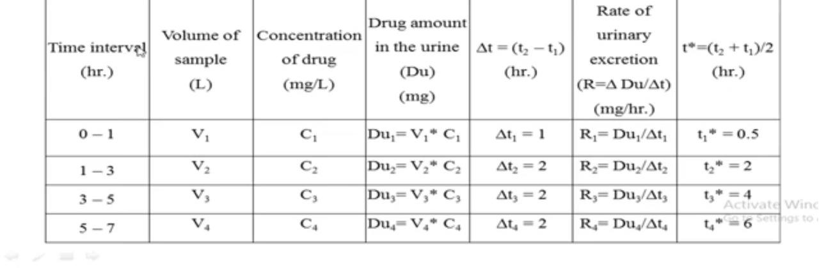
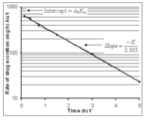
Excretion Rate Method
If the rate of excretion is plotted against the average time (mid point of collection period) (t*), on semilogarithmic paper, the slope will permit the determination of the elimination rate constant (K); and the intercept will represent the initial rate of excretion (KuA0).
Slope = - kT/2.303
Intercept = A^{O} Kr
K total= K renal + K non-renal

Slide 7
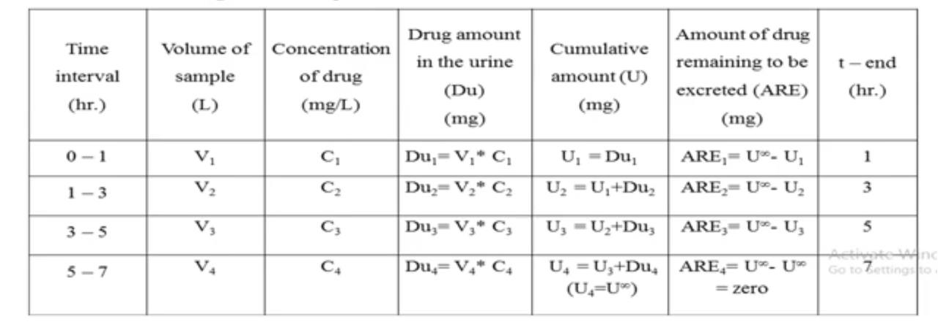
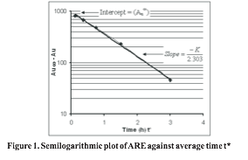
Sigma-minus method/ amount remaining to be excreted (ARE) method
A plot of the amount of drug remaining to be excreted (ARE) against time (t ) on semilogarithmic co-ordinates gives a straight line.
Slope= -KT/2.303

Slide 9
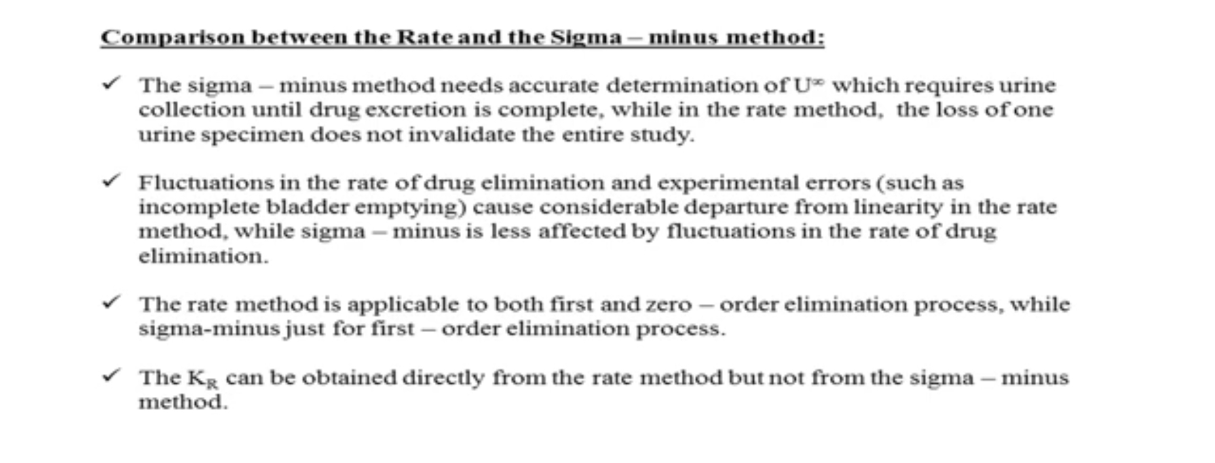
Rate excretion method Vs.
The ''amount remaining to be excreted'' (ARE) method (sigma-minus method).

Slide 10
Practical Example

Slide 11


